Slide 1
Are your personal data at risk? App analytics to the rescue
Prajit Kumar DaS
Advised by: Dr. Anupam Joshi
Co-advisor: Dr. Tim finin
In collaboration with: Drs. Nilanjan Banerjee, Ryan Robucci, TING ZHU, SANDEEP NARAYANAN

Slide 2
Hypothesis
Permission analytics will help us find vulnerabilities in Android apps.
Permissions are enough to classify apps into app purpose categories.
Will yield outlier apps.
Will help us generate Rules for access control.

Slide 3
Motivation

Slide 4
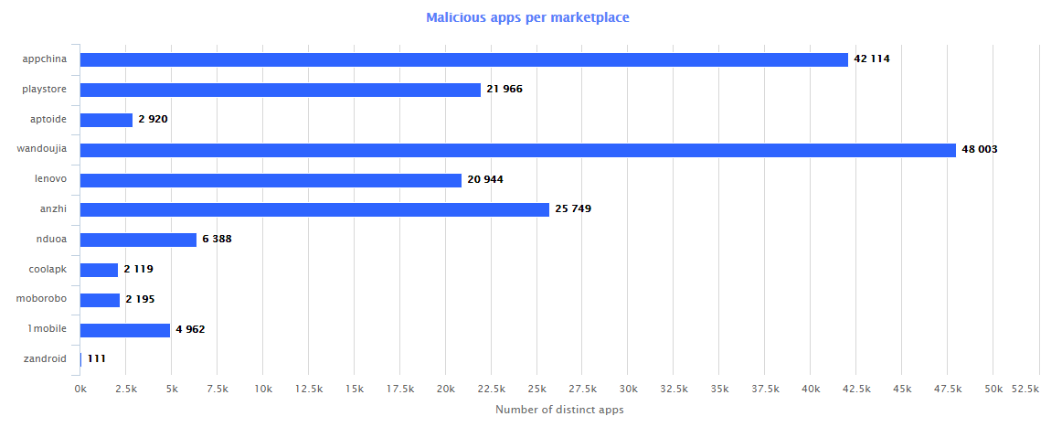
Worldwide marketplace(s) malware stats
Image credit ADMIRE

Slide 5
Flaws in coding standards
National Health Service (England) tests programs to ensure clinical data safety standards
Despite the strict vetting process apps were recently found to have flouted privacy standards and sent data without encrypting it
Found in study by Dr. Kit Huckvale at the Imperial College of London
Analyzing and finding flaws in new apps from older observed patterns is necessary
Ref: Apps for asthma self-management: a systematic assessment of content and tools

Slide 6
Malware apps
The Stagefright vulnerability
Free download of spy apps to capture user SMS, bank mTANs and voice calls
Detecting vector attacks like Stagefright, is it possible?
The Nemesys project proposes a malware taxonomy to detect app malware behavior: Bots, SMS sender, Infostealer, Privilege elevator, Rootkits, Trojan Bank, Adware and Droppers

Slide 7
Users don’t know (or perhaps care)
Users’ data is being shared without their knowledge as per CMU study
Users rarely read or understand permissions
“Privacy nudges” were used to make them aware of data sharing
There is a need to automatically find out rules that would protect users’ data

Slide 8
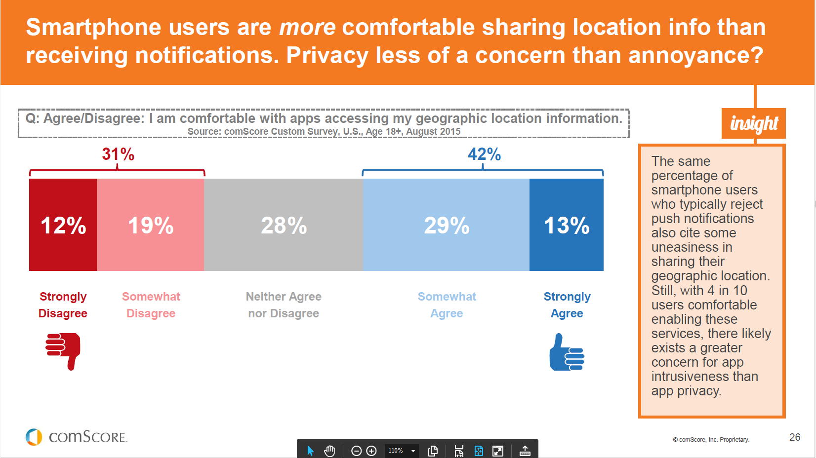
Users don’t know (or perhaps care)
Source: 2015 US Mobile app report

Slide 9
Related Work

Slide 10
Related work
Checking App Behavior Against App Descriptions
Uses clustering in app categories
Uses LDA to generate topics in app descriptions
Does a good job with respect to detecting app behavior
ADMIRE
System lets you analyze different Android marketplaces
Match type, Ad, Deletion time, Deletion Behavior
Searching potentially malicious applications.
Uses signature matching(md5) for strong match
Uses package matching for weak match
Detects existence of Malware apps using the signature matching techniques
Further detected market hopping, studied deletion rates of apps from marketplaces
Rates marketplaces with respect to all the above factors
We are different from ADMIRE because we focus on app permissions info and app metadata

Slide 11
System Architecture

Slide 12

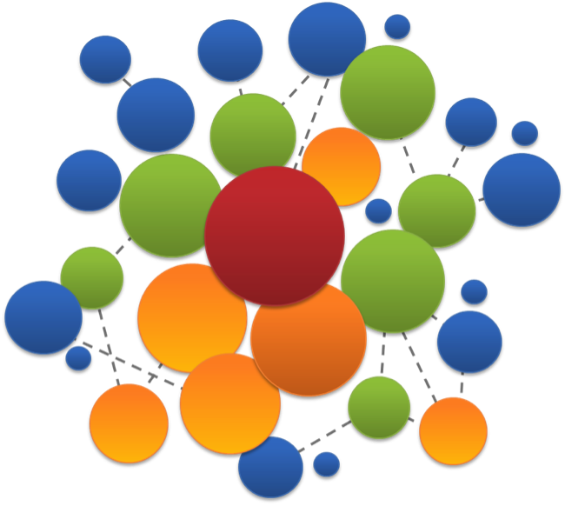





System Architecture
Stage 1: Data Collection
Stage 2: Unsupervised Learning
Stage 3: Static/Dynamic Analytics, Prediction and Heuristics generation

Slide 13
Experimental data
What does the data look like?

Slide 14
Data collection stats
According to AppBrain
Current number of Android apps in the market: 1,660,965 (as of August 24, 2015)
54 App categories including Medical and Health & Fitness
49,024 Health & Fitness Apps and 25,034 Medical Apps
App data collected
Total app data collected: 1,305,103
48,231 Health & Fitness Apps and 23,855 Medical Apps
Does not reflect app permission info
Total number of apps whose permissions have been collected: 933,480
26,248 Health & Fitness Apps and 14,247 Medical Apps

Slide 15
A bit more stats
Apps request
235,869 unique permissions
Top 20 requested permissions are shown
Number of apps requesting permission | Permission Name
859199 | android.permission.INTERNET
726725 | android.permission.ACCESS_NETWORK_STATE
560329 | android.permission.READ_EXTERNAL_STORAGE
557428 | android.permission.WRITE_EXTERNAL_STORAGE
346285 | android.permission.READ_PHONE_STATE
294205 | android.permission.WAKE_LOCK
263031 | android.permission.ACCESS_FINE_LOCATION
247873 | android.permission.ACCESS_WIFI_STATE
237815 | android.permission.ACCESS_COARSE_LOCATION
234052 | android.permission.VIBRATE
194944 | android.permission.GET_ACCOUNTS
193073 | com.google.android.c2dm.permission.RECEIVE
152209 | android.permission.CAMERA
103478 | android.permission.CALL_PHONE
93749 | android.permission.RECEIVE_BOOT_COMPLETED
77515 | android.permission.RECORD_AUDIO

Slide 16
A bit more stats
Top 20 requested permissions by: Healthcare apps
Number of apps requesting permission | Permission Name
24600 | android.permission.INTERNET
20506 | android.permission.ACCESS_NETWORK_STATE
15240 | android.permission.READ_EXTERNAL_STORAGE
15203 | android.permission.WRITE_EXTERNAL_STORAGE
9164 | android.permission.READ_PHONE_STATE
8986 | android.permission.ACCESS_FINE_LOCATION
8462 | android.permission.WAKE_LOCK
8163 | android.permission.ACCESS_COARSE_LOCATION
7694 | android.permission.VIBRATE
7439 | com.google.android.c2dm.permission.RECEIVE
7107 | android.permission.GET_ACCOUNTS
5293 | android.permission.ACCESS_WIFI_STATE
5062 | android.permission.CAMERA
3809 | android.permission.CALL_PHONE
3210 | android.permission.RECORD_AUDIO
2578 | android.permission.RECEIVE_BOOT_COMPLETED

Slide 17
A bit more stats
Top 20 requested permissions by: Medical apps
Number of apps requesting permission | Permission Name
13484 | android.permission.INTERNET
11198 | android.permission.ACCESS_NETWORK_STATE
8393 | android.permission.READ_EXTERNAL_STORAGE
8367 | android.permission.WRITE_EXTERNAL_STORAGE
4477 | android.permission.READ_PHONE_STATE
4191 | android.permission.ACCESS_FINE_LOCATION
4164 | com.google.android.c2dm.permission.RECEIVE
4036 | android.permission.GET_ACCOUNTS
3930 | android.permission.WAKE_LOCK
3821 | android.permission.ACCESS_COARSE_LOCATION
3694 | android.permission.VIBRATE
2765 | android.permission.ACCESS_WIFI_STATE
2688 | android.permission.CAMERA
2436 | android.permission.CALL_PHONE
1551 | android.permission.RECEIVE_BOOT_COMPLETED
1545 | android.permission.RECORD_AUDIO

Slide 18
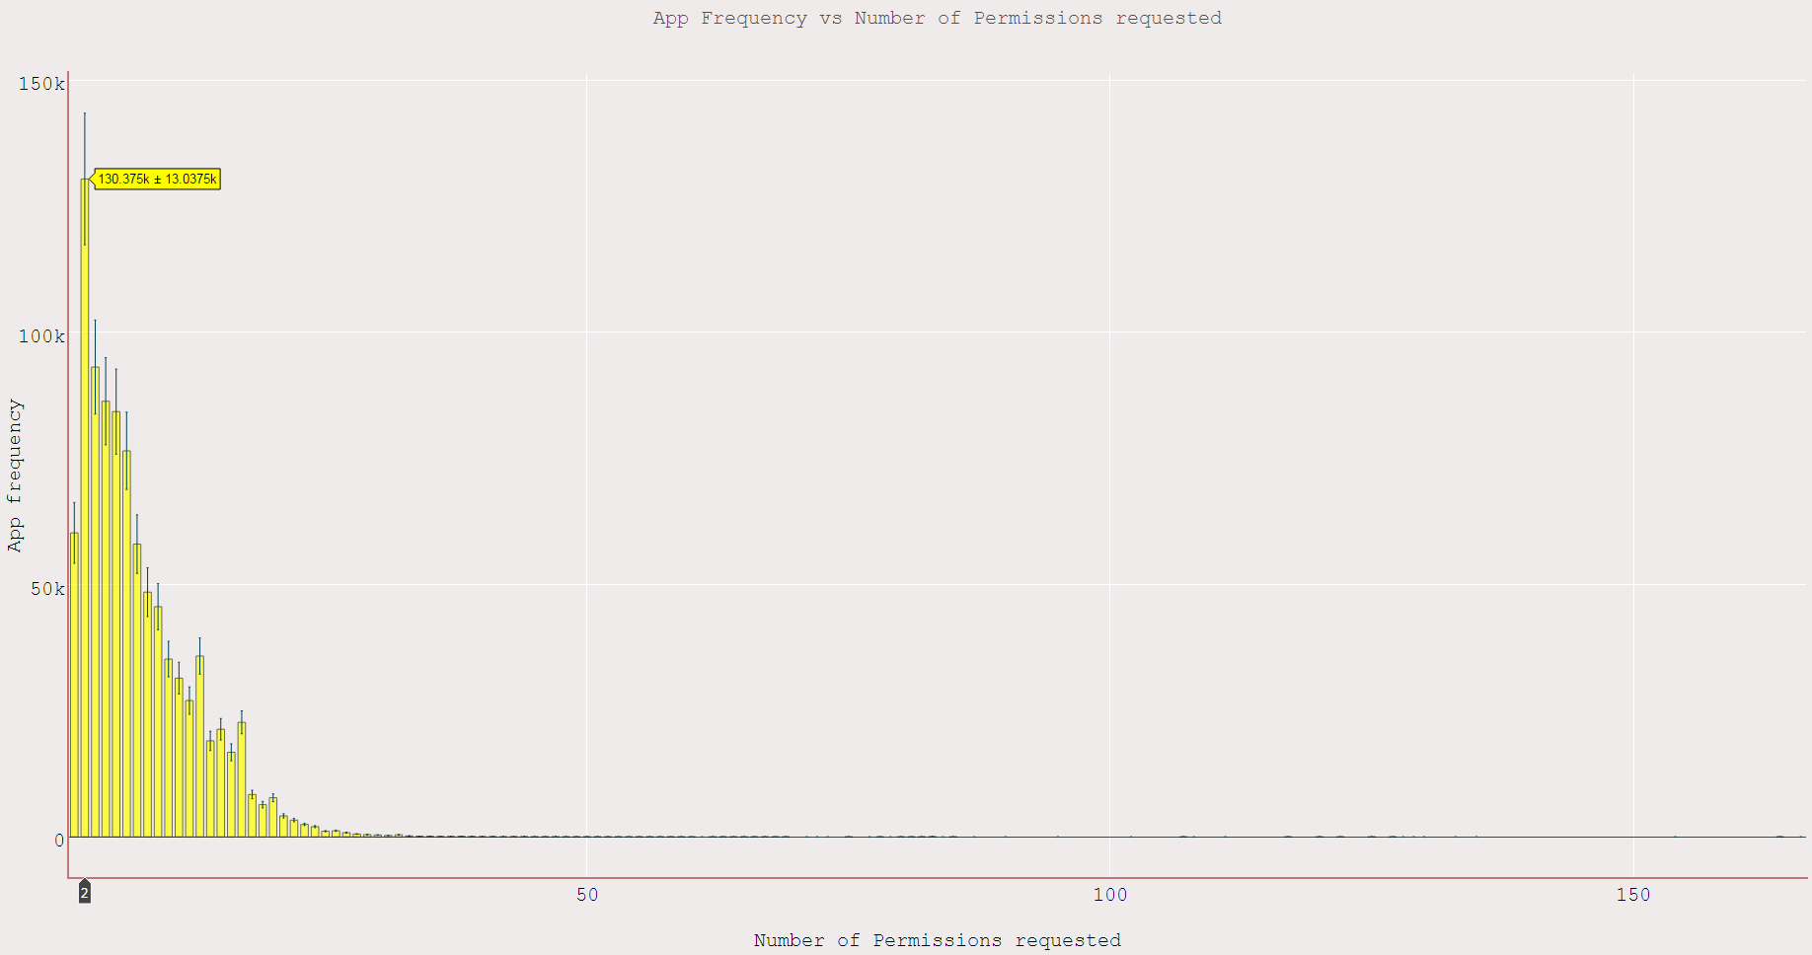
App frequency vs Permissions requested
App Package Nzame | Permissions Count
com.blinkbuddies.musicalbabymobile | 166
com.marthogames.muffinbutton | 164
com.jakkarrlgames.mathguru | 164
com.marthogames.starlander | 164
com.fuengfahsoft.grabtiles | 164
com.mwm.theball | 164
com.brainandheart.brainheart | 164
com.flyingcat.retroracing | 164
com.mwm.thequest | 164
com.cloudgames.snake2d | 164
com.jtwtw.god | 154
com.posstream.Monitor | 135
com.mls.updater | 133
com.luiseduardohd.nid.miqueridosanta | 130
com.team.angryballs | 129
com.team.halloweenslicer | 128
com.aqh.medways | 127
jp.ryosuke.matsuuchi.testpermissions | 127
com.webkey | 125
com.cloudshell | 125
com.eurotronik.inurse | 125

Slide 19
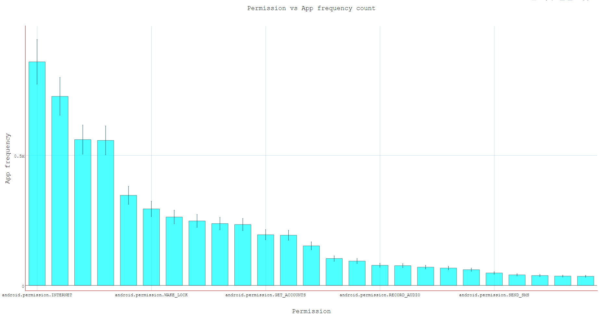
Top requested permissions
App Count | Permission Name
859199 | android.permission.INTERNET
726725 | android.permission.ACCESS_NETWORK_STATE
560329 | android.permission.READ_EXTERNAL_STORAGE
557428 | android.permission.WRITE_EXTERNAL_STORAGE
346285 | android.permission.READ_PHONE_STATE
294205 | android.permission.WAKE_LOCK
263031 | android.permission.ACCESS_FINE_LOCATION
247873 | android.permission.ACCESS_WIFI_STATE
237815 | android.permission.ACCESS_COARSE_LOCATION
234052 | android.permission.VIBRATE
194944 | android.permission.GET_ACCOUNTS
193073 | com.google.android.c2dm.permission.RECEIVE
152209 | android.permission.CAMERA
103478 | android.permission.CALL_PHONE
93749 | android.permission.RECEIVE_BOOT_COMPLETED
77515 | android.permission.RECORD_AUDIO
76072 | com.android.vending.BILLING
70459 | com.google.android.providers.gsf.permission.READ_GSERVICES
66856 | android.permission.READ_CONTACTS
60587 | android.permission.GET_TASKS
48008 | android.permission.SEND_SMS
40795 | com.android.vending.CHECK_LICENSE
38237 | android.permission.READ_CALL_LOG
35931 | android.permission.ACCESS_LOCATION_EXTRA_COMMANDS
35250 | android.permission.WRITE_CONTACTS

Slide 20
Evaluation methods
What experiments did we run?
What did we find?

Slide 21
Cluster evaluation
Cluster evaluation measures:
Internal: Detects the right number of clusters by measuring cluster tightness
Silhouette Coefficient : Calculated using the mean intra-cluster distance (a) and the mean nearest-cluster distance (b) for each sample as (b - a) / max(a, b).
Gives a notion of how each point lies within the cluster and how they are dissimilar to other clusters.
Other measures:
Davies–Bouldin index (1974) Ratio between inter cluster and intra cluster distance: Low value is good
External: Measures cluster assignment against ground truth
Completeness Score: A clustering result satisfies completeness if all the data points that are members of a given class are elements of the same cluster.
Homogeneity Score: A clustering result satisfies homogeneity if all of its clusters contain only data points which are members of a single class.
Notes:
B is too high then you are far apart from other clusters and tightly packed.
If a is too high then you are not tightly packed and could have overlapping points.
If b = a then the clusters aren’t bad but differentiation of points is difficult
Completeness = Precision
Homogeneity = Recall

Slide 22
K-Means Clustering

Slide 23
K – Means: Process
Select K points as initial centroids
Repeat
Form K clusters by assigning each point to its closest centroid
Re-compute the centroids (cluster mean point) of each cluster
Until convergence: No more changes in cluster assignment
What we did:
Step 1: Transform an app to a vector rep by marking the permissions it requests
Step 2: Use vector as an input to K-Means clustering – Does app category become evident?
Step 3: Use different distance metrics and check with cluster evaluation results

Slide 24
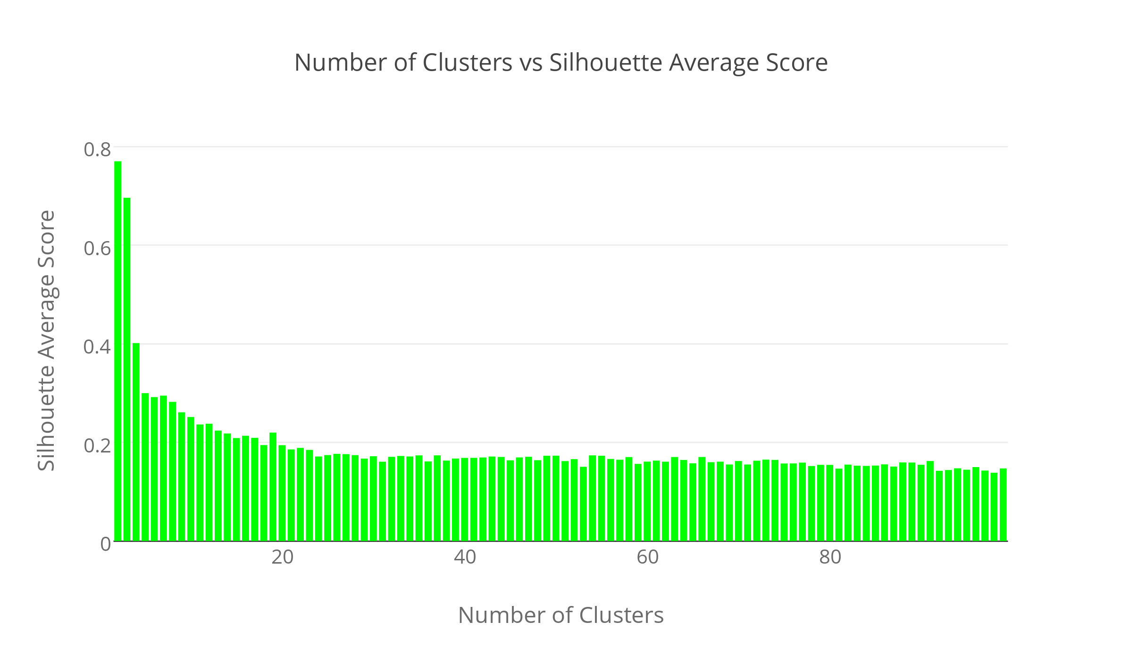
Internal measures – Euclidean

Slide 25
Internal measures – Manhattan

Slide 26
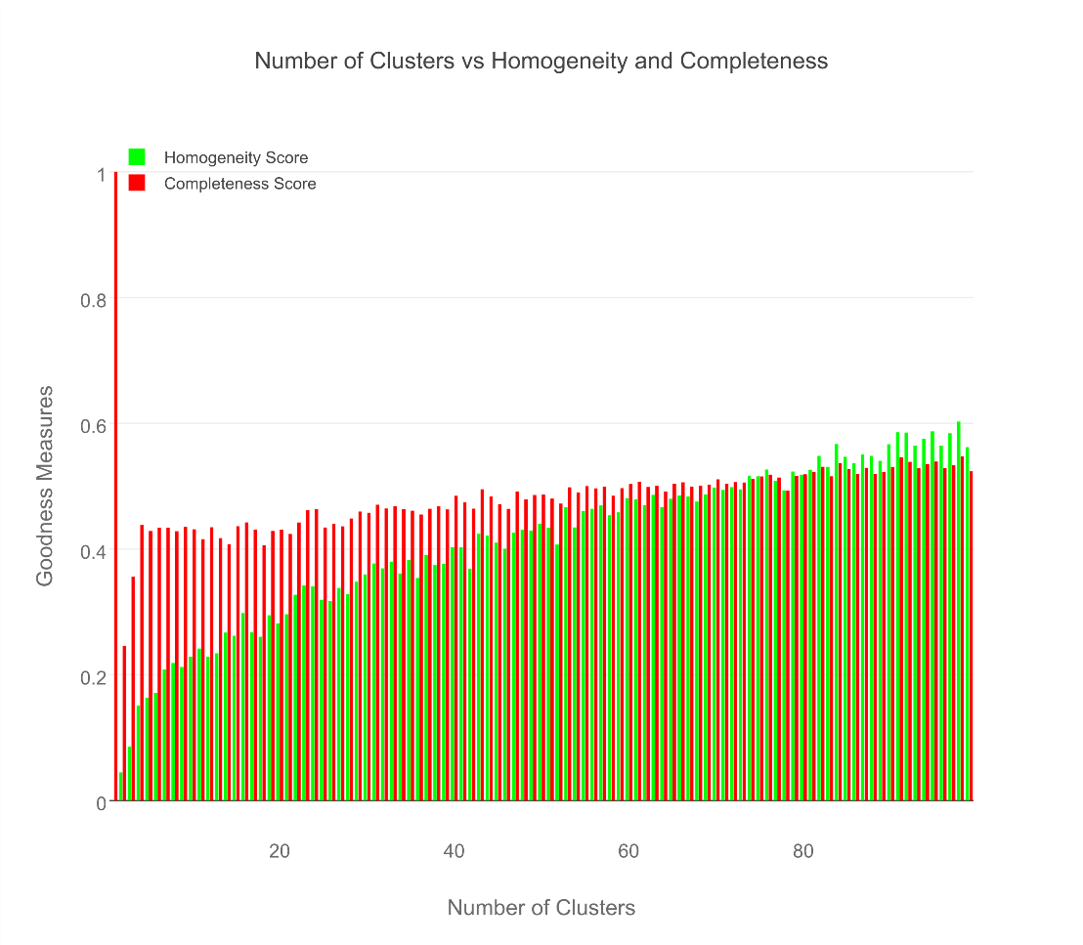
External measures

Slide 27
Results for Medical & Healthcare Apps
AppPkgName | Cluster Assignment | AppCategory
com.fitnow.loseit | 13 | Health & Fitness
com.webmd.android | 13 | Health & Fitness
com.drugscom.app | 13 | Medical
com.ovuline.pregnancy | 13 | Medical
air.com.peppapig.paintbox | 13 | Educational
com.t11.skyviewfree | 13 | Education
gov.nasa | 13 | Education
com.google.android.stardroid | 13 | Books & Reference
com.turner.cnvideoapp | 13 | Media & Video
com.nextradioapp.nextradio | 13 | Music & Audio
com.camerasideas.instashot | 13 | Photography
com.foxsports.videogo | 13 | Sports
com.theopen | 13 | Sports
com.tregware.radar | 13 | Weather

Slide 28
Results for All Medical Apps
AppPkgName | Cluster Assignment | AppCategory
com.drugscom.app | 13 | Medical
com.ovuline.pregnancy | 13 | Medical
com.jardogs.fmhmobile | 14 | Medical
com.goodrx | 49 | Medical
com.microphone.earspy | 65 | Medical
com.hp.pregnancy.lite | 75 | Medical
com.carezone.caredroid.careapp.medications | 80 | Medical
com.smsrobot.period | 94 | Medical
epic.mychart.android | 96 | Medical

Slide 29
Results for All Health & Fitness Apps
AppPkgName | Cluster Assignment | AppCategory
com.fitnow.loseit | 13 | Health & Fitness
com.webmd.android | 13 | Health & Fitness
com.period.tracker.lite | 27 | Health & Fitness
com.popularapp.periodcalendar | 27 | Health & Fitness
com.cvs.launchers.cvs | 32 | Health & Fitness
com.babycenter.pregnancytracker | 54 | Health & Fitness
com.fitbit.FitbitMobile | 60 | Health & Fitness
com.myfitnesspal.android | 87 | Health & Fitness
com.google.android.apps.fitness | 91 | Health & Fitness
com.tayu.tau.pedometer | 94 | Health & Fitness

Slide 30
Finance apps seem to pretty uniform
AppPkgName | Cluster Assignment | AppCategory
com.google.android.apps.walletnfcrel | 31 | Finance
com.infonow.bofa | 31 | Finance
com.paypal.android.p2pmobile | 31 | Finance
com.geico.mobile | 32 | Finance
com.creditkarma.mobile | 57 | Finance
com.acorns.android | 58 | Finance
com.chase.sig.android | 58 | Finance
com.venmo | 58 | Finance
com.wf.wellsfargomobile | 58 | Finance

Slide 31
Library Apps seem like the best
AppPkgName | Cluster Assignment | AppCategory
com.aviary.android.feather.plugins.borders.free | 5 | Libraries & Demo
com.aviary.android.feather.plugins.filters.original | 5 | Libraries & Demo
com.aviary.android.feather.plugins.stickers.free_stickers | 5 | Libraries & Demo
com.estrongs.chromecast | 5 | Libraries & Demo
com.foxfi.addon | 5 | Libraries & Demo
com.mxtech.ffmpeg.v7_neon | 5 | Libraries & Demo
com.mxtech.ffmpeg.v7_vfpv3d16 | 5 | Libraries & Demo
com.google.samples.apps.cardboarddemo | 27 | Libraries & Demo
com.google.vr.cardboard.apps.designlab | 27 | Libraries & Demo
com.ivona.tts | 65 | Libraries & Demo
read phone status and identity, full network access, read sensitive log data, full network access, find accounts on the device, control vibration, run at startup, read Google service configuration, full network access, modify or delete the contents of your USB storage, read the contents of your USB storage, Wi-Fi connection information, view Wi-Fi connections, Google Play license check, full network access, prevent device from sleeping, view network connections, precise location (GPS and network-based), draw over other apps

Slide 32
What did we see in cluster 5?
read phone status and identity, full network access
read sensitive log data, full network access
find accounts on the device, control vibration, run at startup, read Google service configuration, full network access
modify or delete the contents of your USB storage, read the contents of your USB storage, Wi-Fi connection information, view Wi-Fi connections, Google Play license check, full network access, prevent device from sleeping, view network connections
precise location (GPS and network-based), draw over other apps

Slide 33
A Hypothesis and Problems faced
Hypothesis: Common permissions aren’t distinguishing, perhaps uncommon ones are
Feature set of 239k unique app permissions and data space of 1 million app samples
High dimensionality problem: Clustering process runs out of memory
Data space possibly non-convex
Cluster analysis does not produce good results
Solution?
Use Spectral clustering, which uses a notion of affinity of data instead of Euclidean distance
Will be able to carry out clustering in non-convex data space
Will help reducing the high dimensional feature representation to a lower dimensional space

Slide 34
Spectral Clustering
Using Weighted Jaccard Similarity Metric

Slide 35
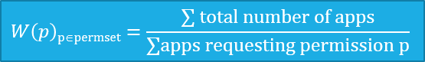
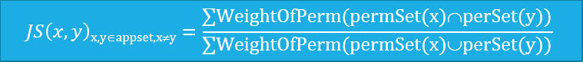
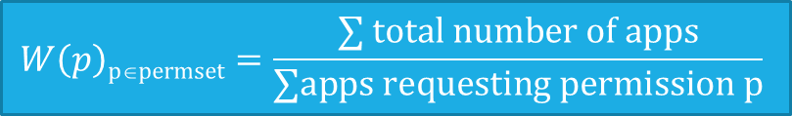

Spectral: Process
Step 1: Compute weights for all app permissions found using following function.
Step 2: Create vector of permissions for each app.
Step 3: For each app pair compute Weighted Jaccard Similarity metric as below:
Step 4: Use the computed similarity metric as an input to Spectral Clustering
$$W\left(p\right)\text{p}\text{∈}\text{perm}\text{set}=\frac{\text{∑} total number of apps}{\text{∑}\text{apps} \text{requesting} \text{permission} \text{p}}$$
$$JS\left(x,y\right)\text{x}\text{,}\text{y}\text{∈}\text{appset}\text{,}\text{x}\text{≠}\text{y}=\frac{\text{∑}\text{WeightOfPerm}\text{(}\text{permSet}\text{(}\text{x}\text{)∩}\text{perSet}\text{(}\text{y}\text{))}}{\text{∑}\text{WeightOfPerm}\text{(}\text{permSet}\text{(}\text{x}\text{)∪}\text{perSet}\text{(}\text{y}\text{))}}$$

Slide 36
Spectral: Process
Pre processing
Construct affinity matrix for all data points (using similarity metric)
Decomposition
Compute eigenvalue and eigenvectors of the matrix
Using dimensionality reduction algorithms map each point to a lower-dimensional representation
Thus representing matrix with a set of most dominant eigenvectors
Clustering
Assign clusters using K-Means with the new representation
Notes:
(Graph Laplacian L = D – A)
D is the degree matrix
A is the adjacency matrix (In our case the weighted affinity matrix)

Slide 37
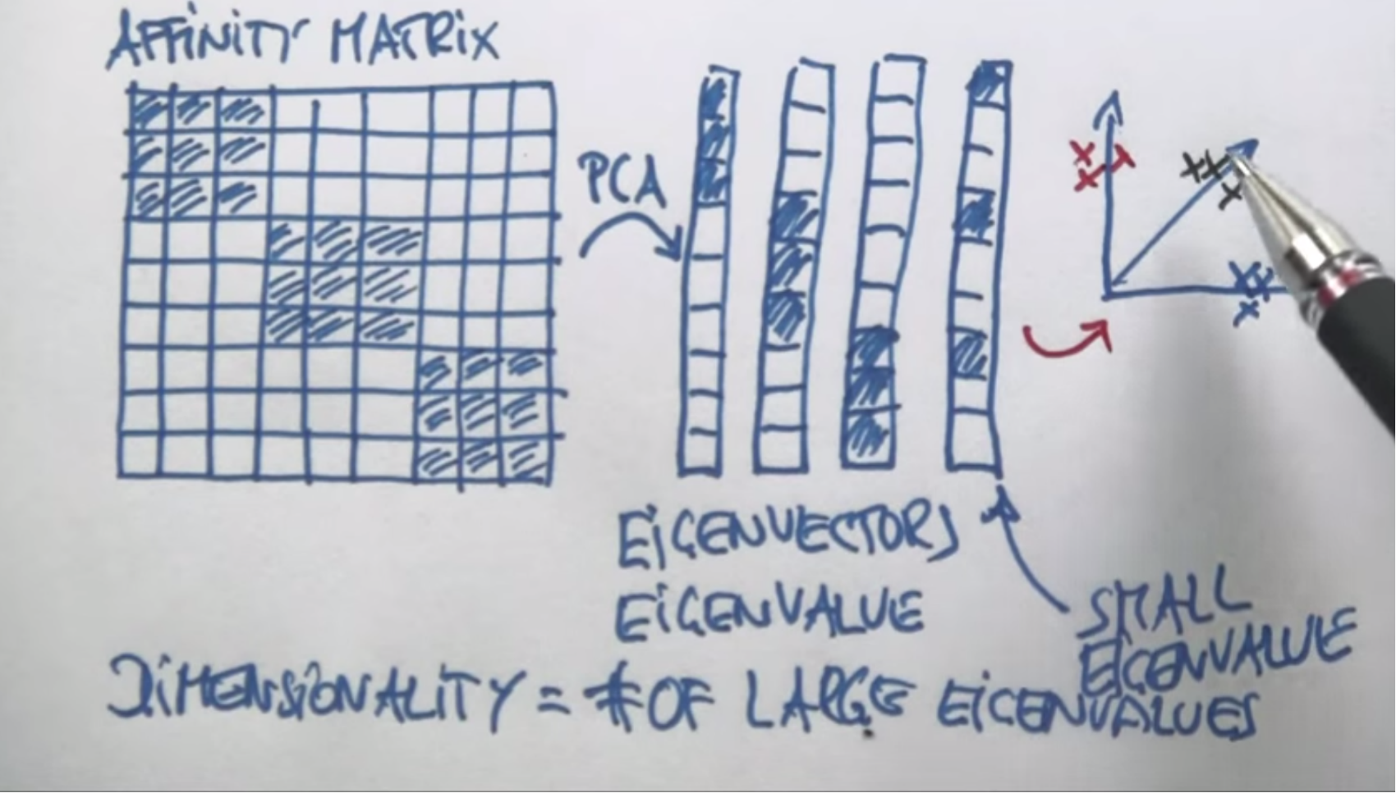
Online tutorial on Spectral Clustering

Slide 38
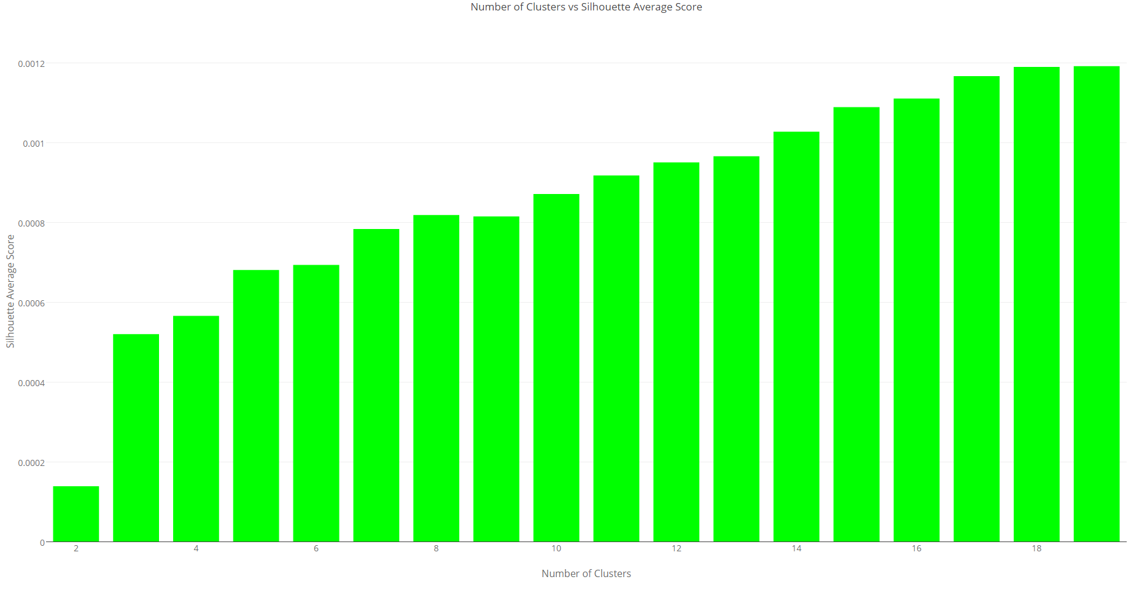
Internal Measures – WJS

Slide 39
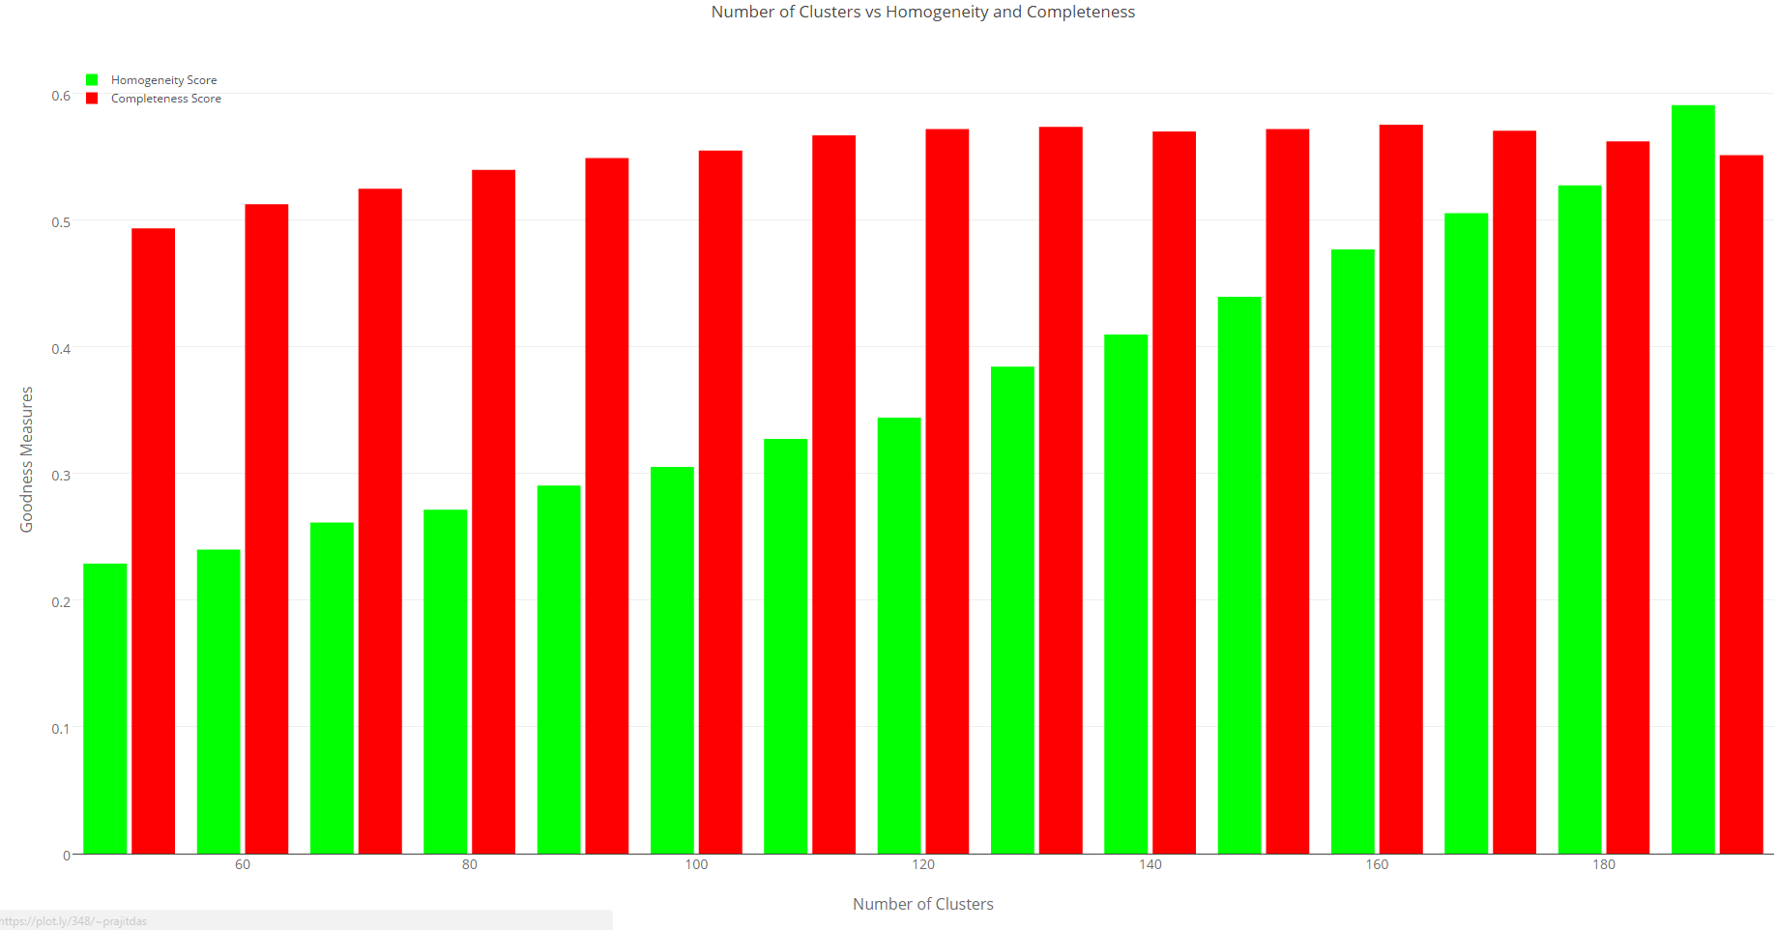
External Measures – WJS

Slide 40
Conclusion

Slide 41
Continuing work
Clustering by itself is not generating usable features for rule generation.
What else can we do?
In Clusters manually annotate apps which are “weird”
Run dynamic analysis on emulator for monitoring app behavior and matching to “weirdness”
Matching app descriptions to app permission requests

Slide 42

Questions?

